Slide 1
Morse Code Practice Kit
200650U - Lasitha Jananjaya

Slide 2
General Info
This device can be used for coding and decoding Morse code.
Code sending process
ASCII code input is received by the module, converted into Morse code, and then converted into audio signal.
Code receiving process
It converts the received audio signal into Morse code, and then convert it into ASCII code and displays it.

Slide 3
Simulation
Done using WOKWI – Online simulator
designs
Altium Designer and Solidworks
Manufacturing
JLCPCB and 3D Printing
Assembly
Hand soldered and Assembled by hand

Slide 4
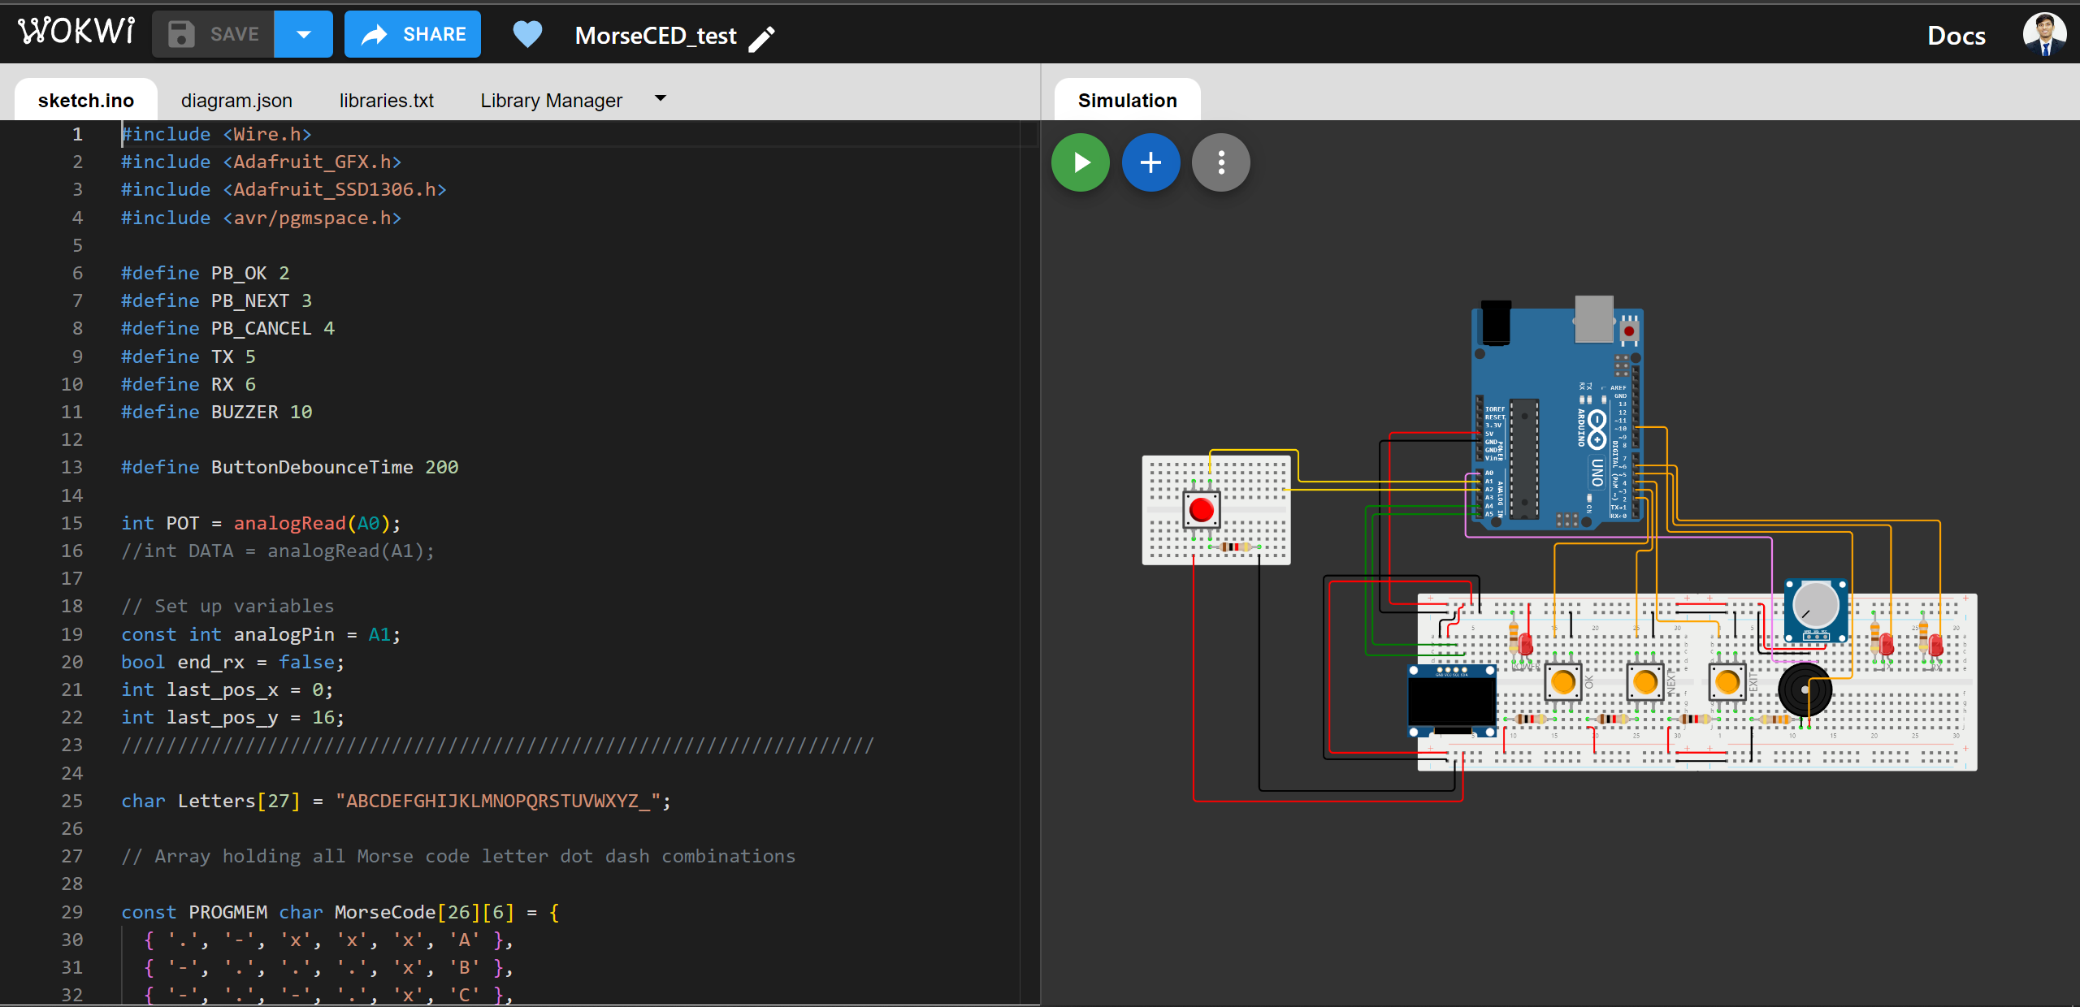
Simulation

Slide 5
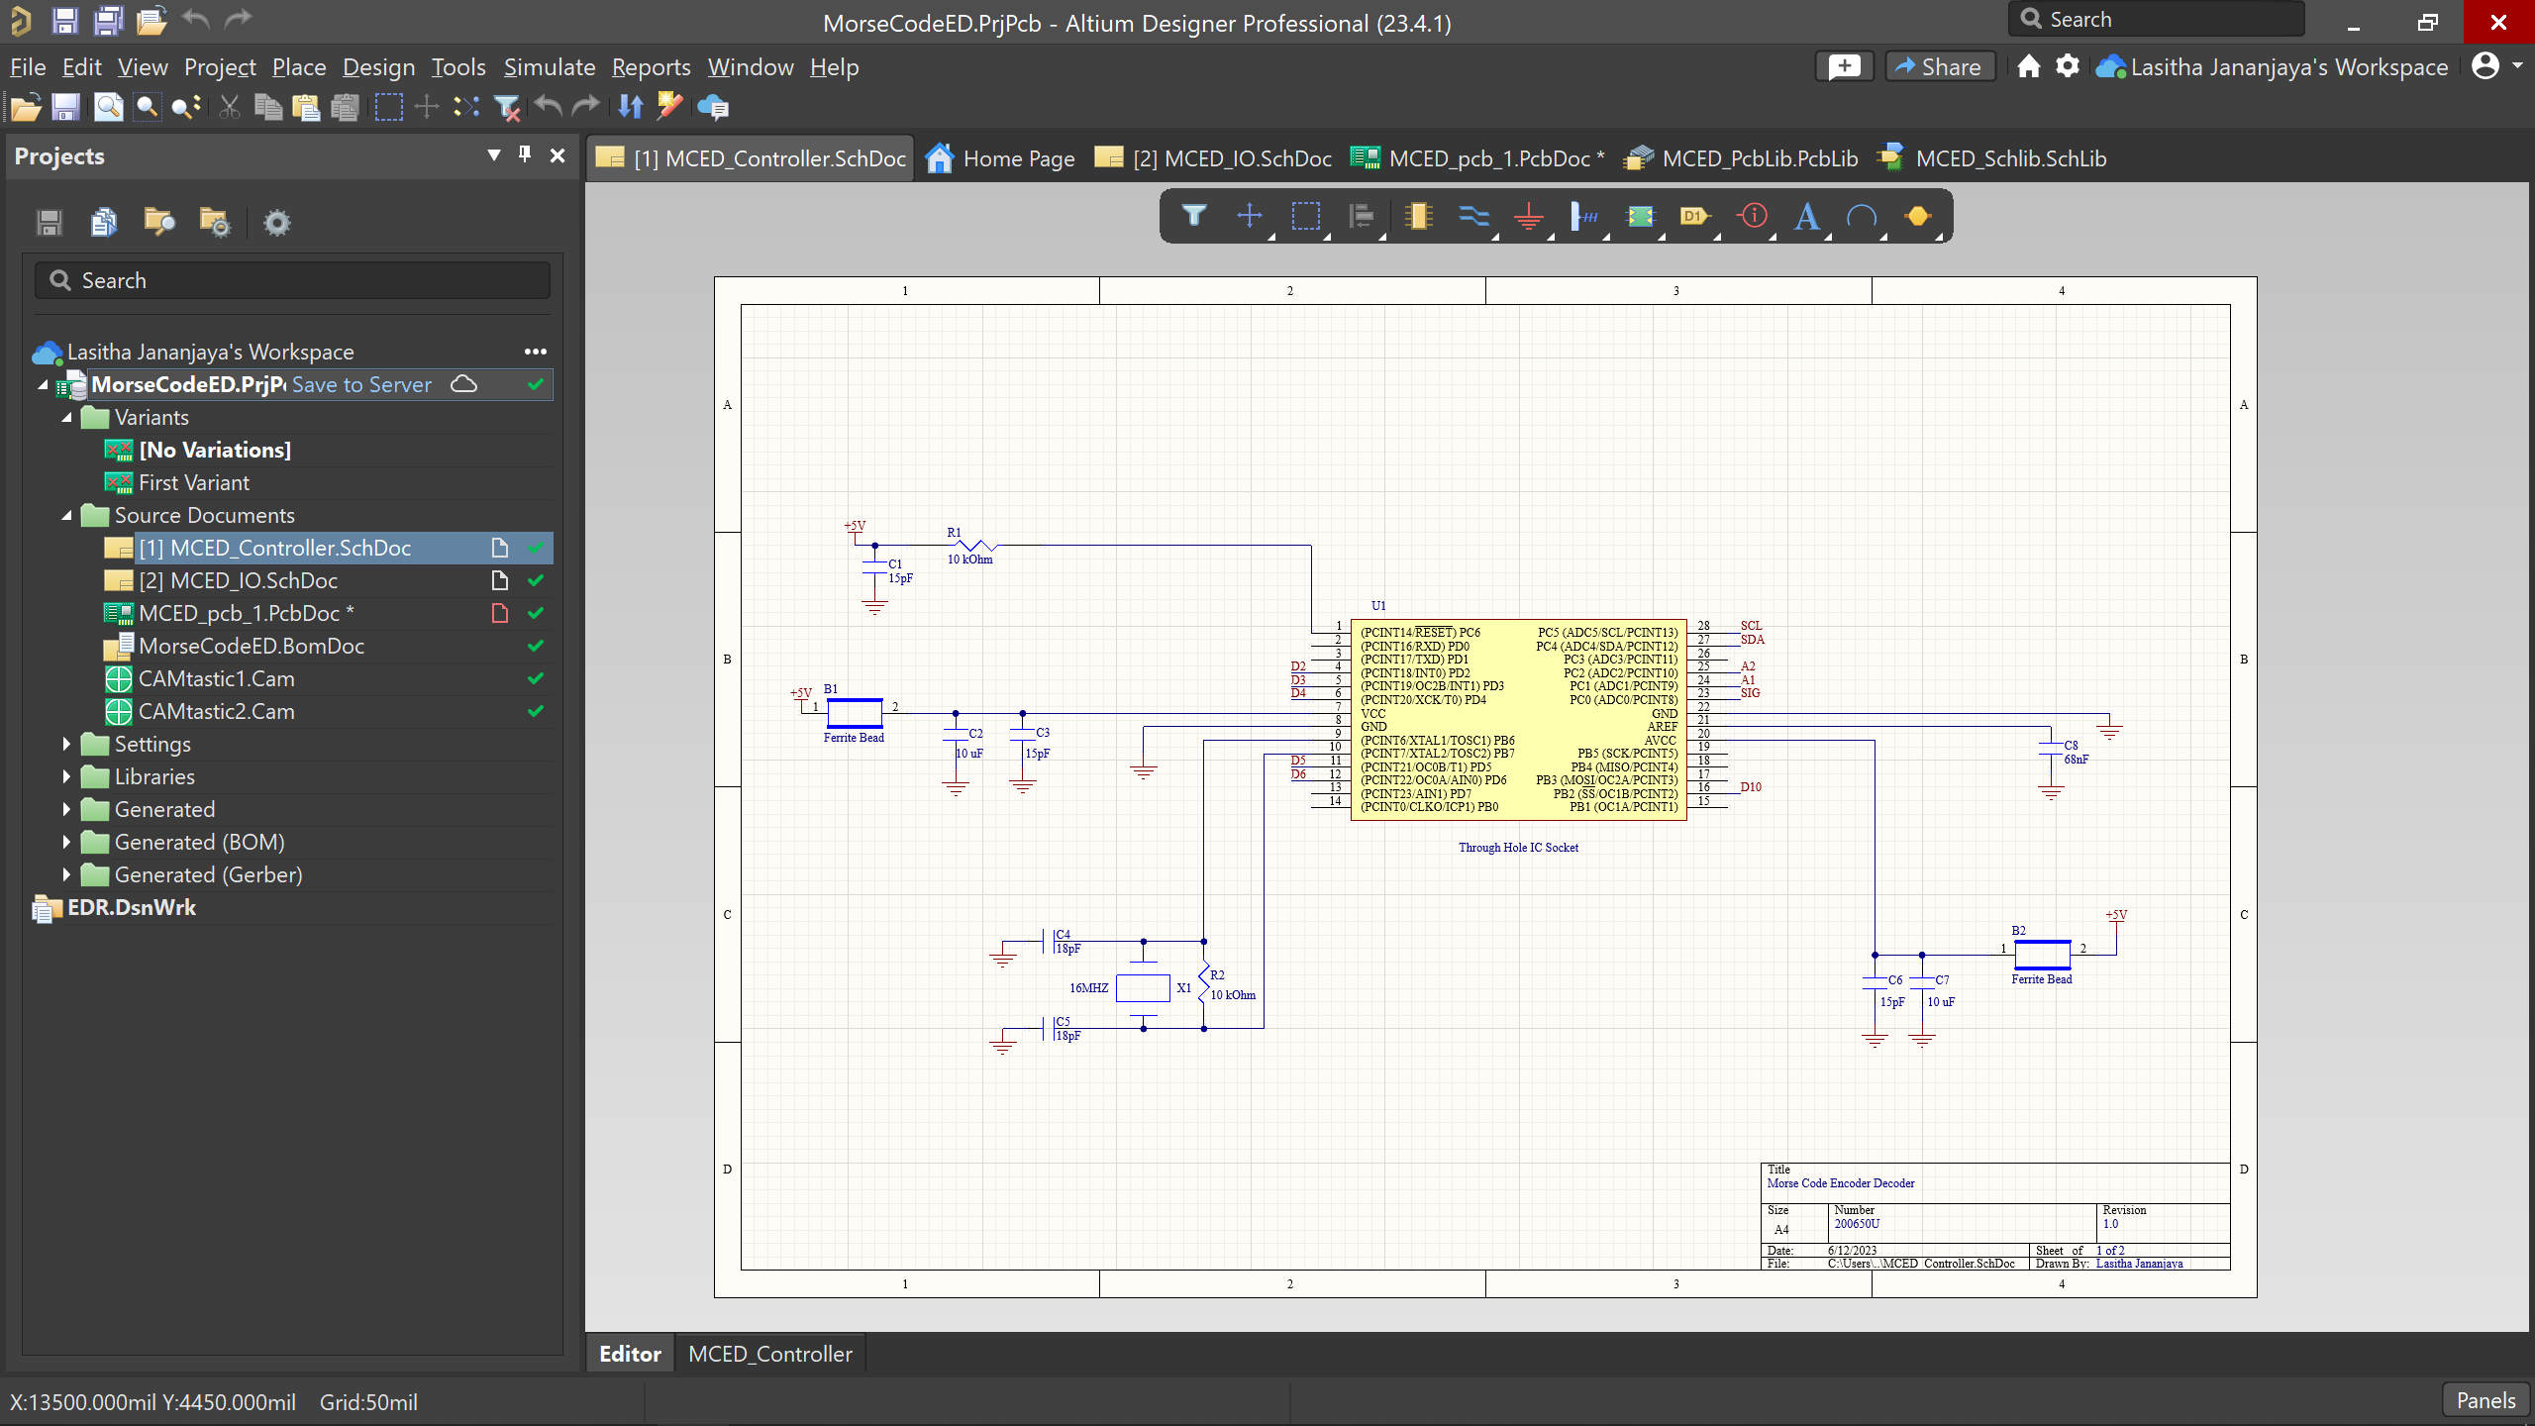
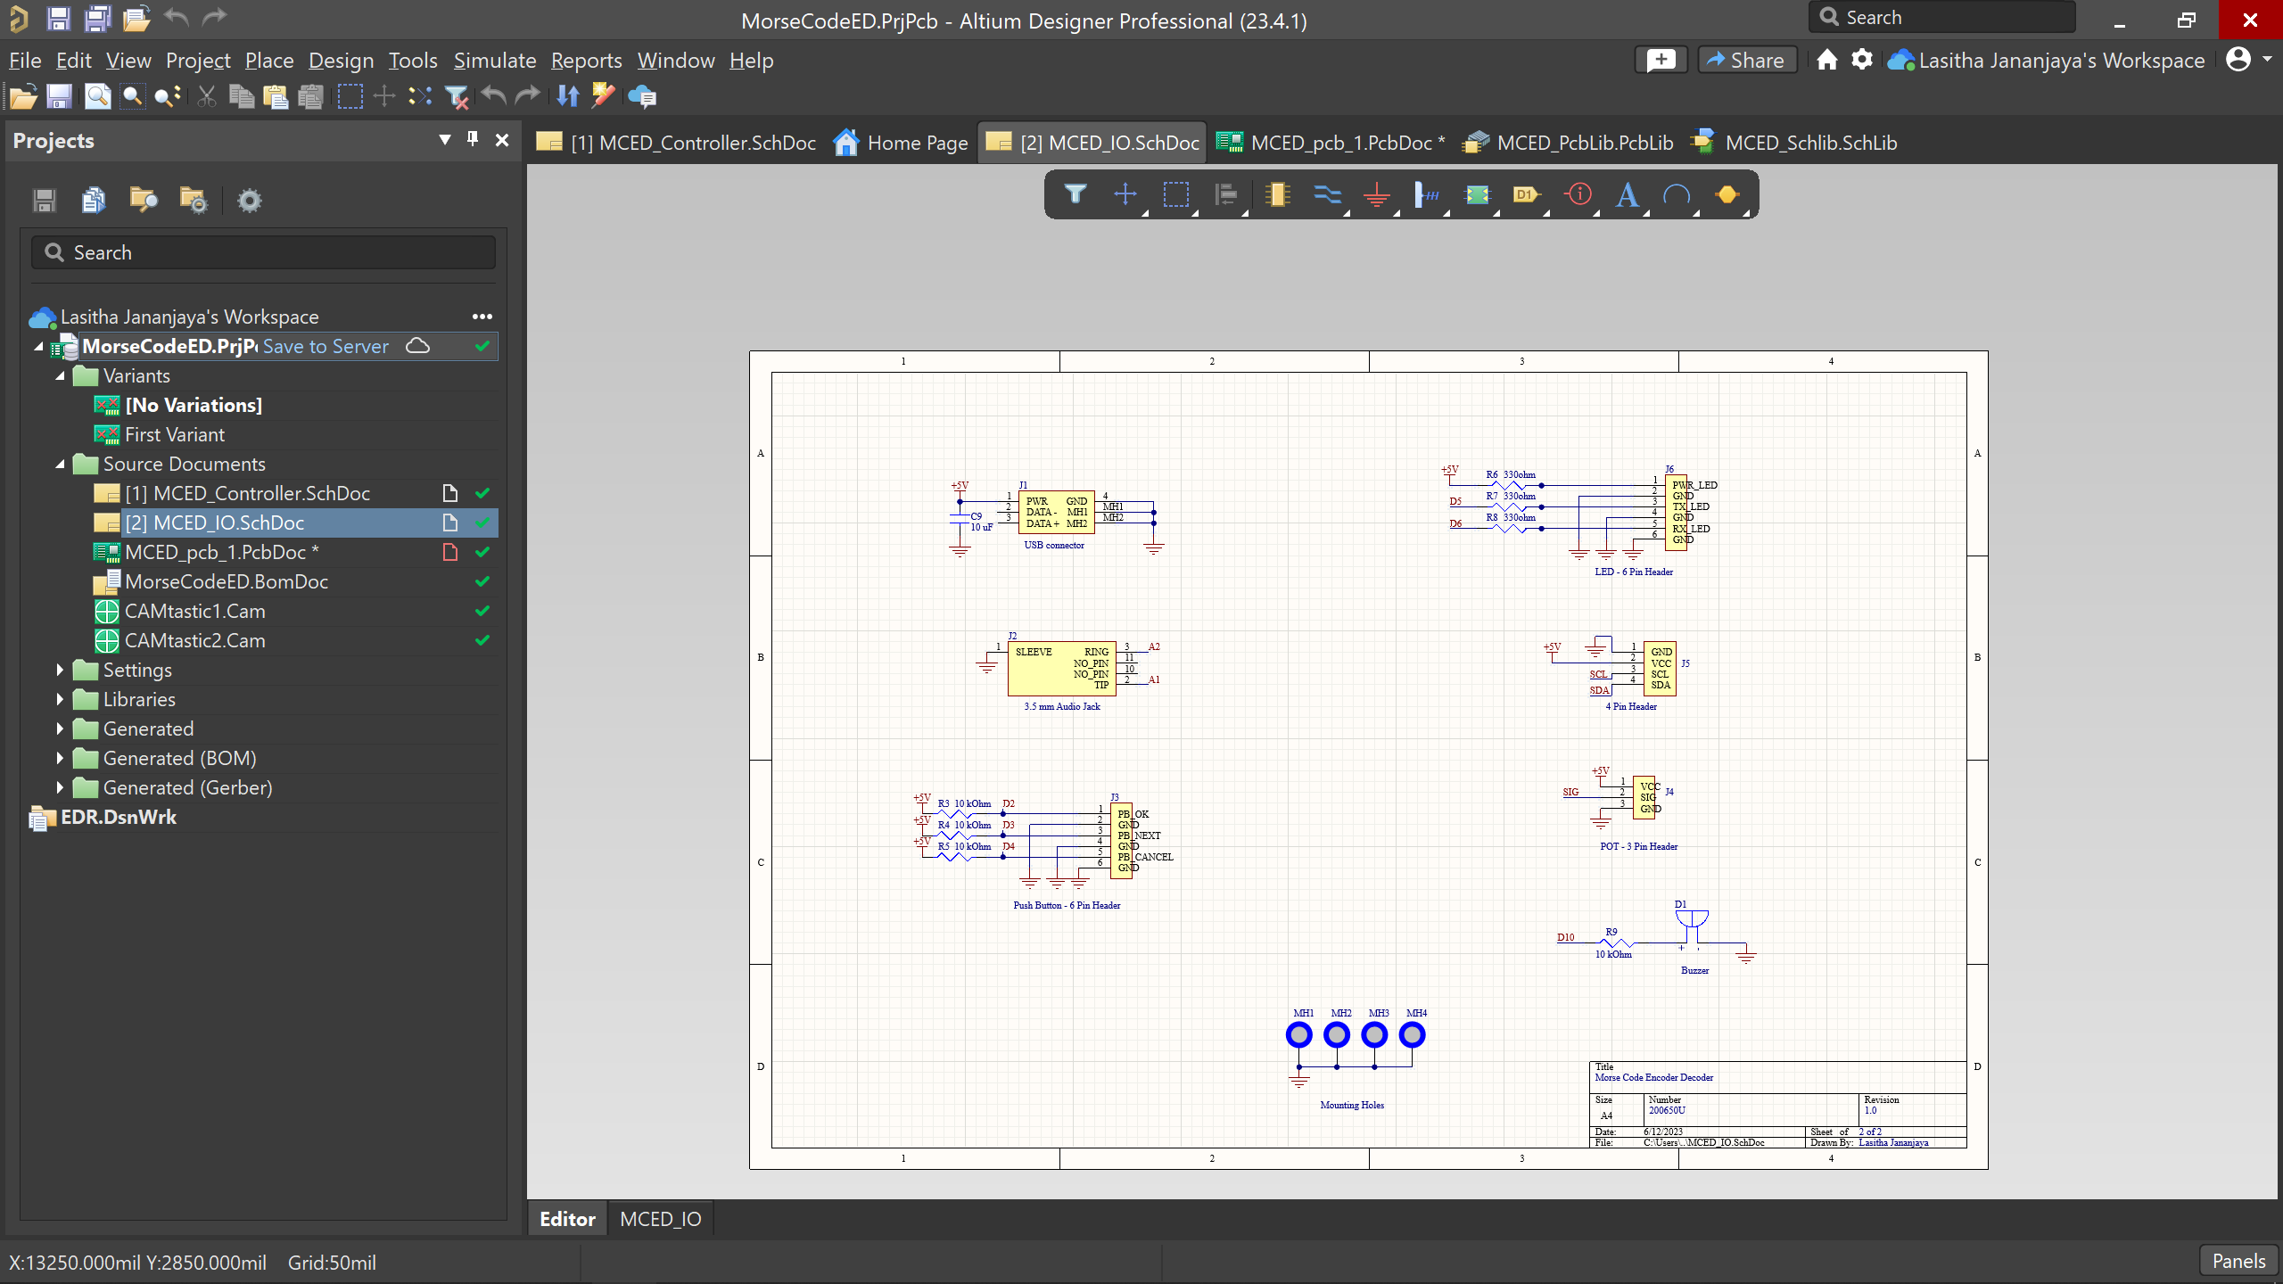
Schematic

Slide 6
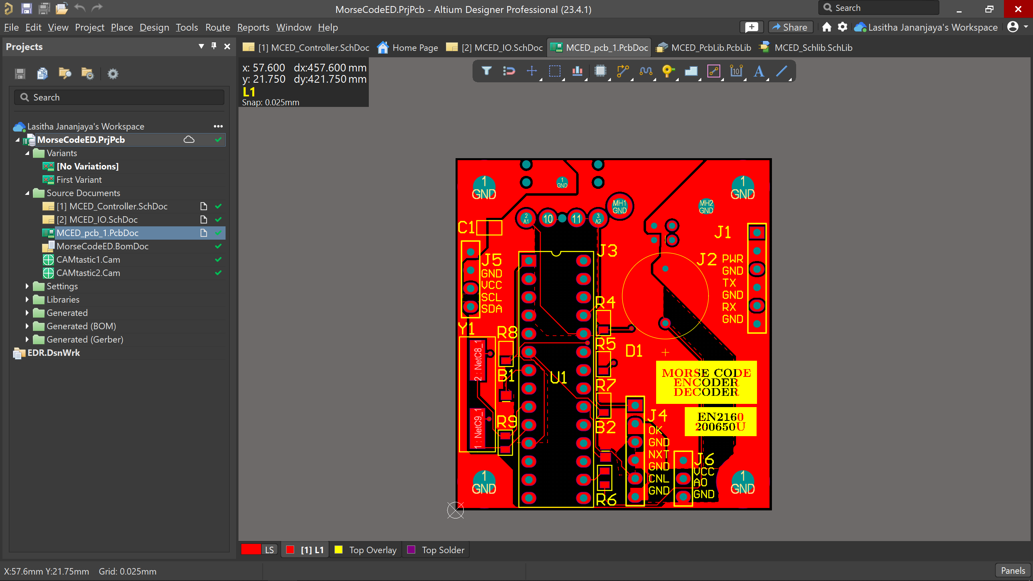
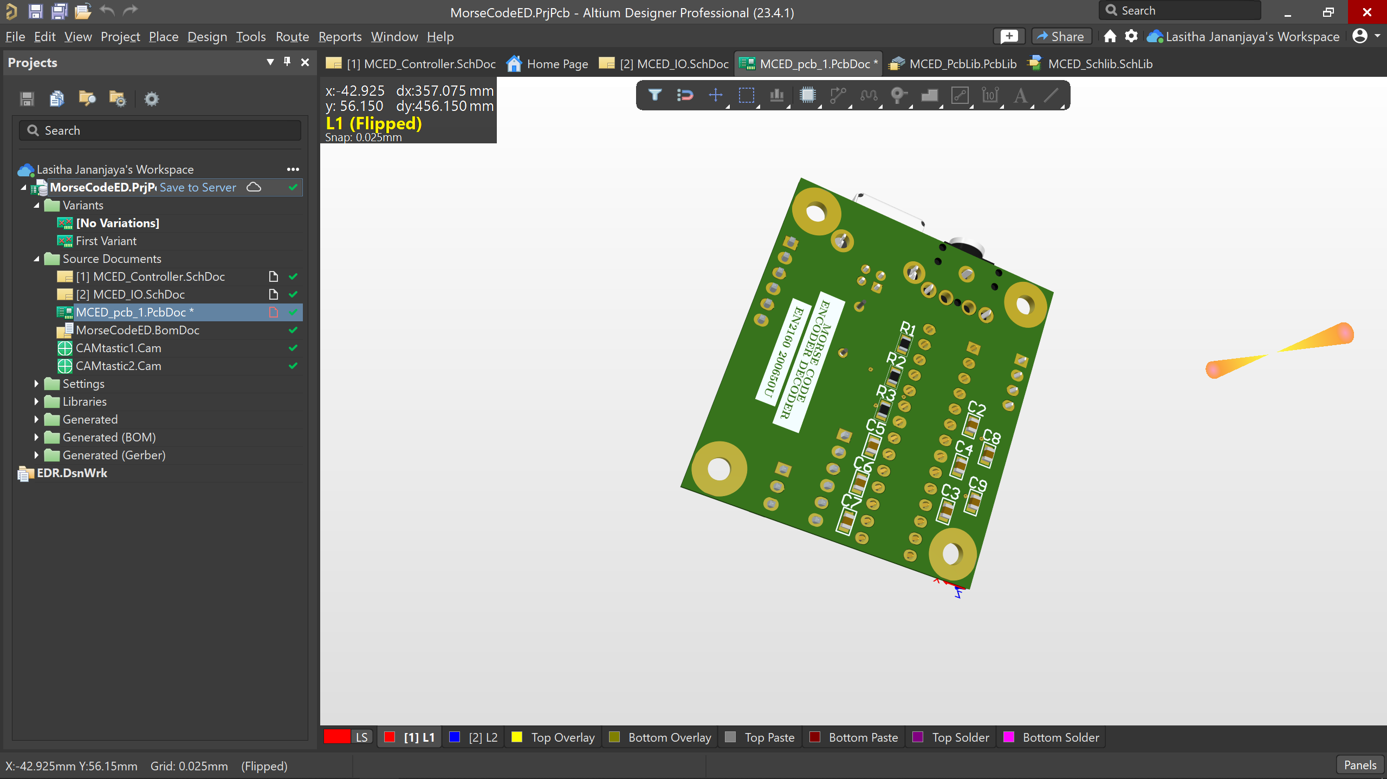
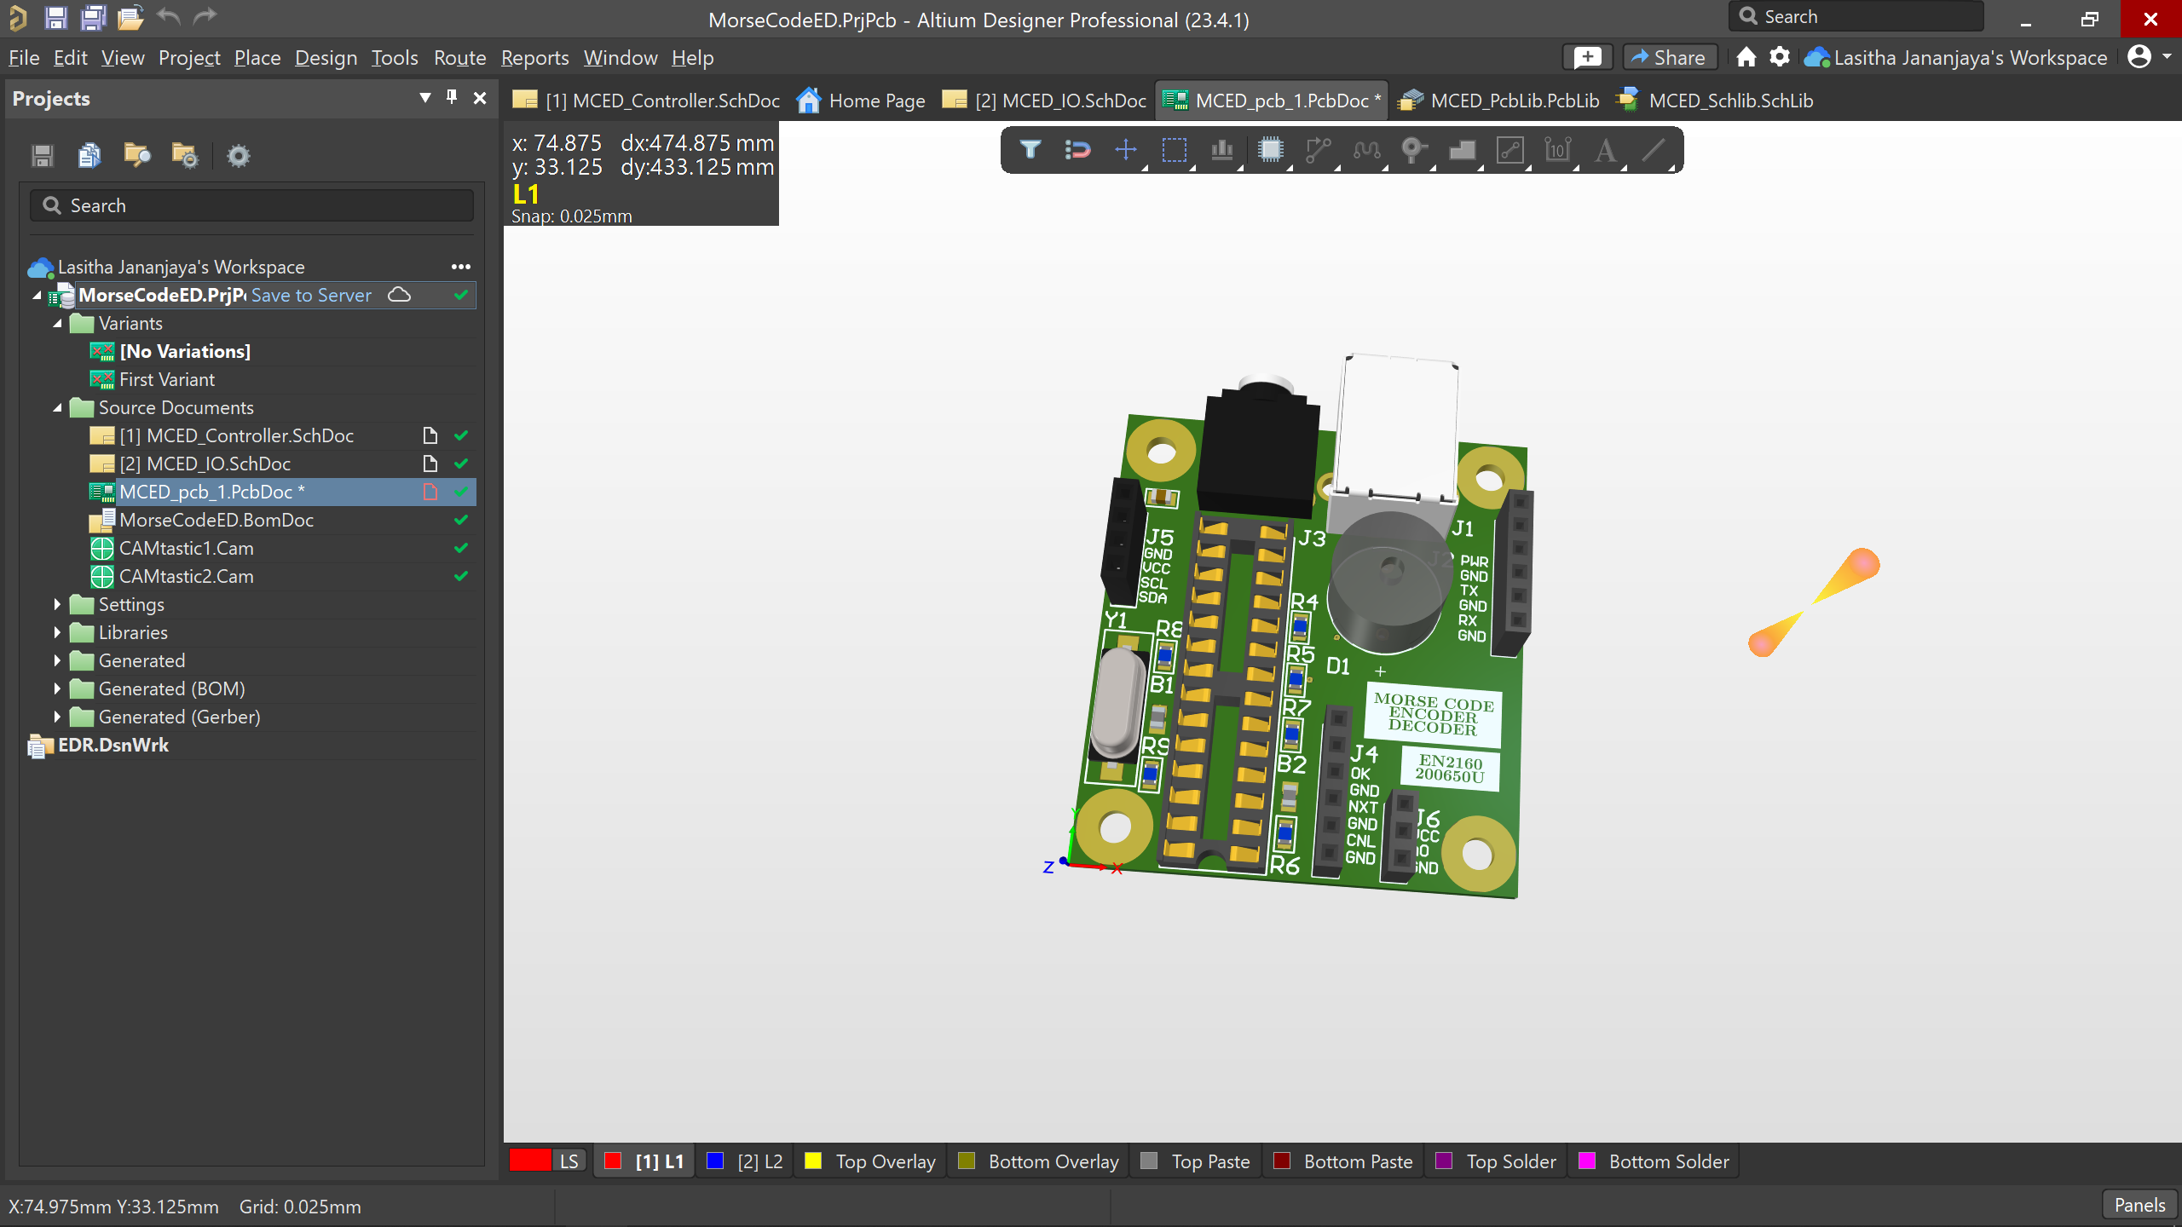
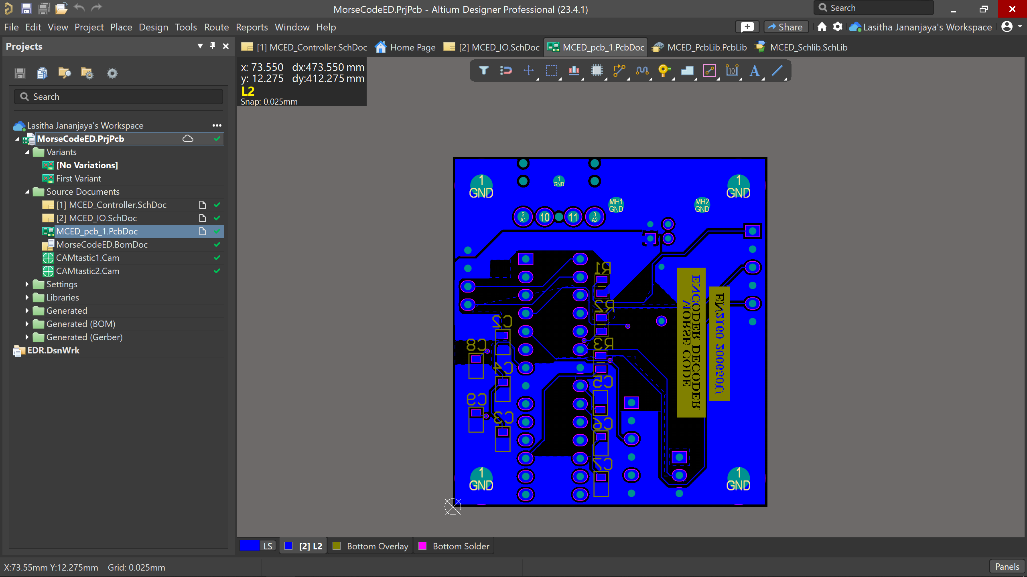
PCB design

Slide 7
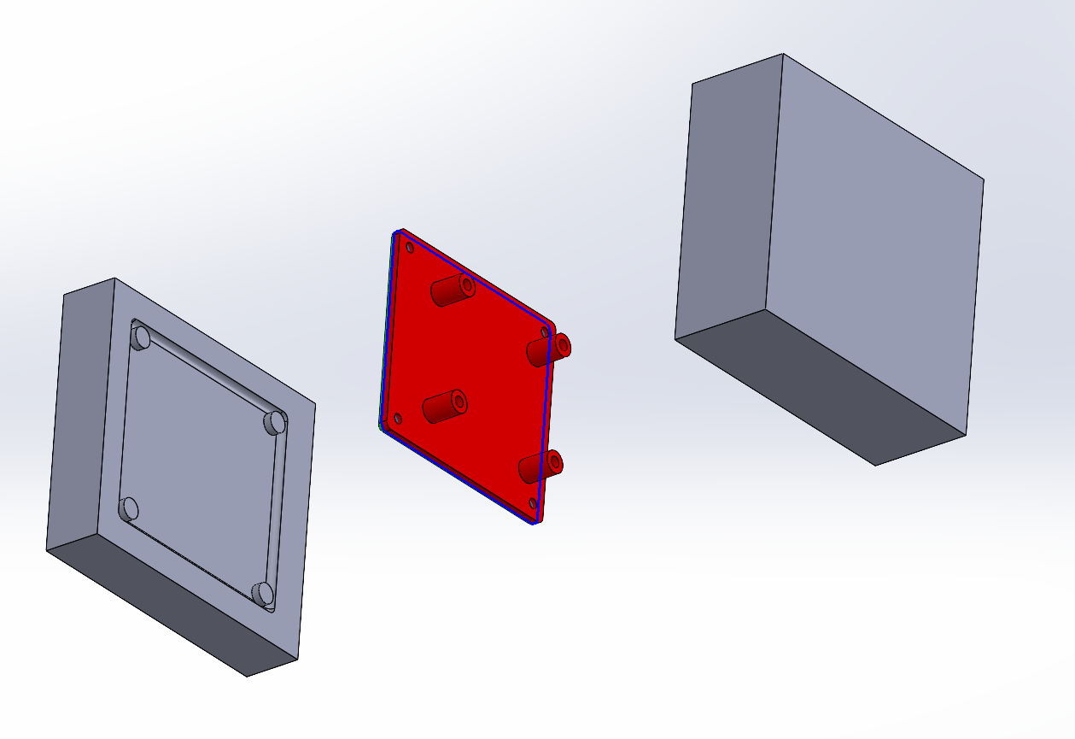
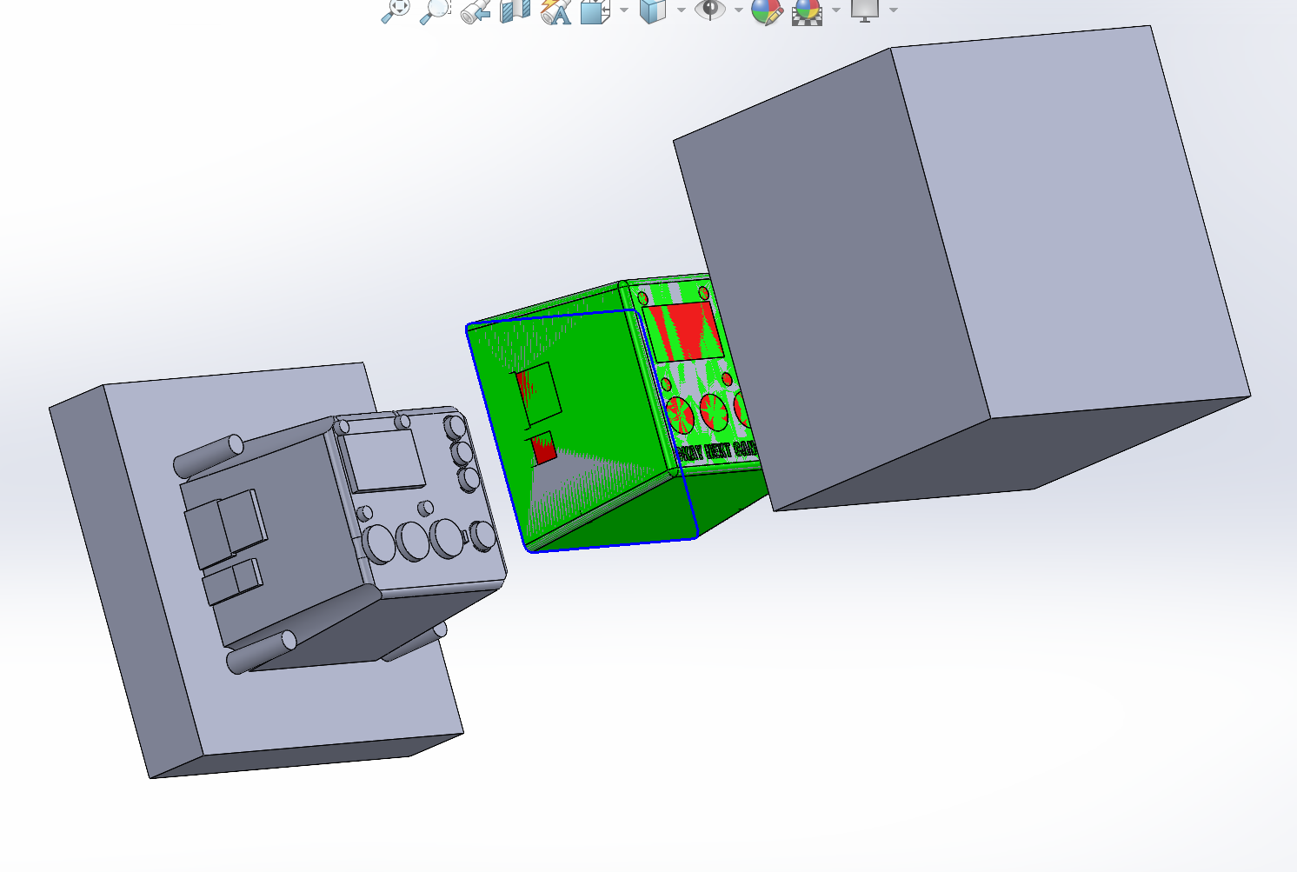
Enclosure

Slide 8
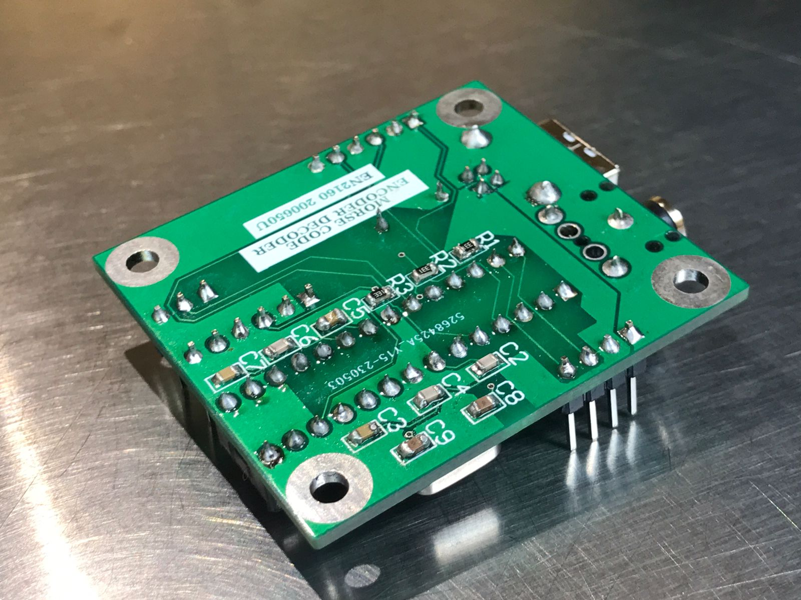
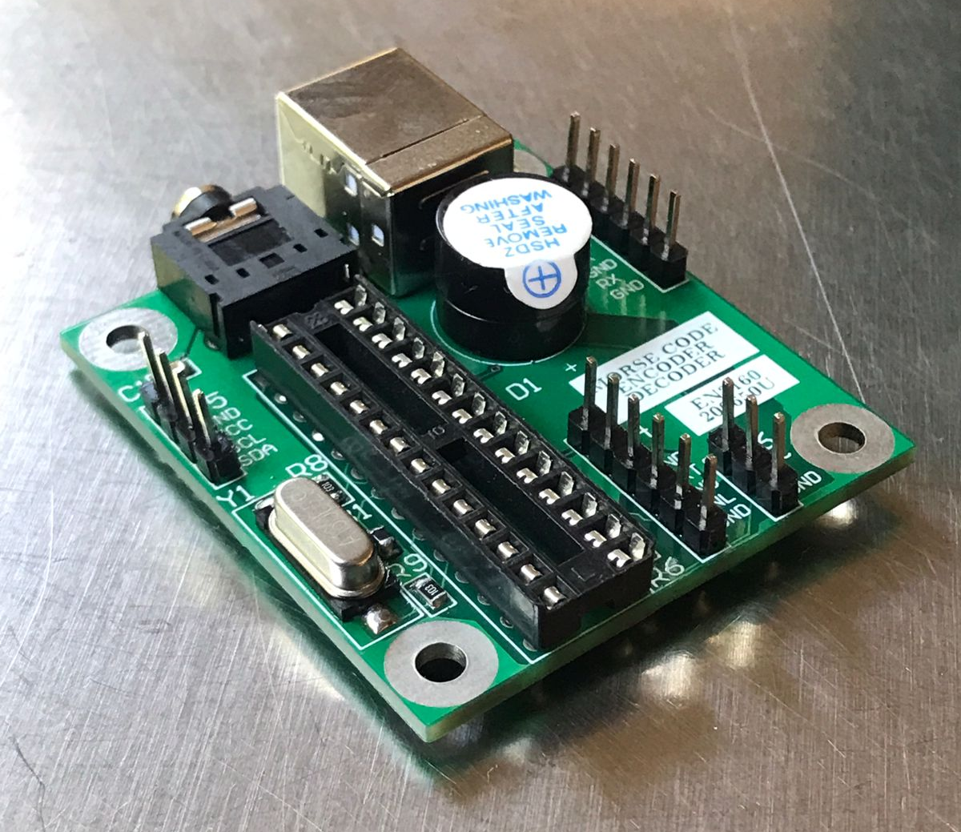
PCB Assembly

Slide 9
THANK YOU
200650U – Lasitha Jananjaya

